Slide 1
3413ICT Network Security
Lecture 5B: Firewalls
Dr V. Muthukkumarasamy
B.Sc.Eng (Hons) (Peradeniya), PhD (Cantab), MIEE, MIEEE

Slide 2
Previous Lecture..
We have studied:
Various malicious programs,
Trapdoor, logic bomb, trojan horse, zombie,
Viruses, worms,
Countermeasures.

Slide 3
Today’s Objectives
To understand the general characteristics of firewalls
To study three types of firewalls
To give an overview of “trusted systems”

Slide 4
Firewalls
seen evolution of information systems
centralized data processing systems with mainframe
LANs interconnecting PCs & mainframe
Enterprise-wide network – geographically distributed & interconnected by a private WAN
now everyone want to be on the Internet
and to interconnect networks

Slide 5
Firewalls
has persistent security concerns
can’t easily secure every system in org
when a security flaw is discovered, each affected system must be upgraded
Hundred or thousands of m/c running on various OS
need "harm minimisation"
a Firewall usually part of this
Inserted between the premises network & Internet
To protect the network from Internet-based attacks

Slide 6
What is a Firewall?
a single choke point of control and monitoring
A firewall may be a single m/c or a set of m/c s that cooperate to perform the firewall functions
interconnects networks with differing trust
imposes restrictions on network services
only authorized traffic is allowed

Slide 7
Firewall ?
auditing and controlling access
can implement alarms for abnormal behavior
Firewall may include network address translator, network management functions that audits or logs Internet usage
Can be a platform for IPSec
is itself immune to penetration
provides perimeter defence

Slide 8
Firewall functions(Exam)
Service control: types of services that can be accessed (inbound & outbound)
Filters traffic on the basis of IP address & TCP port No.
Provides proxy s/w that interprets each service request before passing it on
Direction control of service request
User control: access to a service to which user (local user)
For external users – requires authentication s.a. in IPSec
Behaviour control: controls how particular services are used:
Eg. Firewall may filter email to eliminate spam

Slide 9
Firewall Limitations
cannot protect from attacks bypassing it
eg utility modems, trusted organisations, trusted services (eg SSL/SSH)
cannot protect against internal threats
eg disgruntled employee
cannot protect against transfer of all virus infected programs or files
because of huge range of O/S & file types

Slide 10
Types of Firewall
Three common types:
Packet filers
Application level gateways
Circuit level gateways

Slide 11
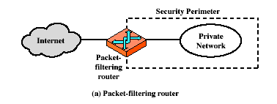
Firewalls – Packet Filters

Slide 12
Firewalls – Packet Filters
simplest of components
foundation of any firewall system
examine each IP packet (no context) and permit or deny according to rules
hence restrict access to services (ports)
possible default policies
that not expressly permitted is prohibited
that not expressly prohibited is permitted

Slide 13
Packet filters
Filtering rules are based on:
Source IP
Destination IP
Source & destination port Nos
IP protocol field (defines transport protocol)
Router interface (which interface ports of router the packet is from or to)

Slide 14
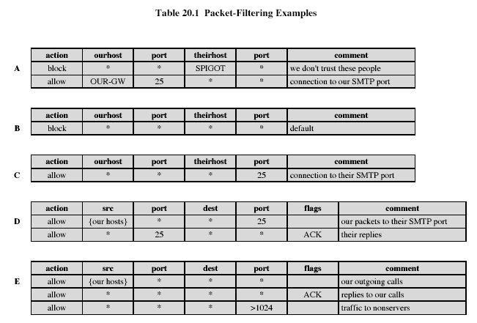
Firewalls – Packet Filters
Notes:
Stallings Table 20-1.

Slide 15
Packet Filters
Advantages:
Simplicity
Transparent to users & very fast
Disadvantages:
Since it does not examine upper layer data, cannot prevent attacks employing application specific vulnerabilities
Limited logging functionality (same infor used to make access control)
Cannot detect network layer address spoofing

Slide 16
Attacks on Packet Filters
IP address spoofing
fake source address (internal) to be trusted
Counter-measure: add filters on router to block
source routing attacks
attacker sets a route other than default
Counter-measure: block source routed packets
tiny fragment attacks
split header info over several tiny packets
Counter-measure: either discard or reassemble before check

Slide 17
Firewalls – Stateful Packet Filters
traditional packet filter makes decisions on individual packet basis
stateful inspection examine each IP packet in context
keeps tracks of client-server sessions
checks each packet validly belongs to one
thus, better able to detect bogus packets out of context

Slide 18
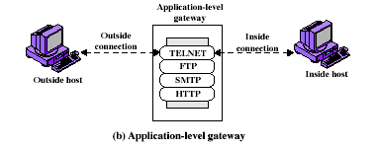
Firewalls - Application Level Gateway (or Proxy)

Slide 19
Firewalls - Application Level Gateway (or Proxy)
use an application specific gateway / proxy
Act as a relay for application level traffic
has full access to protocol
user requests service from proxy
proxy validates request as legal
then actions request and returns result to user
need separate proxies for each service
some services naturally support proxying
others are more problematic
custom services generally not supported

Slide 20
Proxy
Gateway can be configured to support only specific features
Are more secure than packet filters
Can easily log & audit all incoming traffic at the application level
Disadvantage: additional processing overhead on each connection

Slide 21
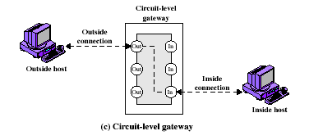
Firewalls - Circuit Level Gateway

Slide 22
Firewalls - Circuit Level Gateway
relays two TCP connections
imposes security by limiting which such connections are allowed
once created usually relays traffic without examining contents
typically used when trust internal users by allowing general outbound connections
Proxy service on inbound connection & circuit level function for outbound connection
eg. Application: SOCKS commonly use this

Slide 23
Bastion Host
Identified by admin as a critical strong point in the network security
highly secure host system
potentially exposed to "hostile" elements
hence is secured to withstand this
Only essential services are installed
may support 2 or more net connections

Slide 24
Bastion..
may be trusted to enforce trusted separation between network connections
runs circuit / application level gateways
or provides externally accessible services
Proxy is configured to support only a subset of standard application’s command set
Each proxy maintains audit information

Slide 25
Firewall configuration
In addition to simple configuration of a single system, more complex configurations are common
Three common configs:
Screened host firewall: single-homed bastion
Screened host firewall: dual-homed bastion
Screened – subnet firewall system

Slide 26
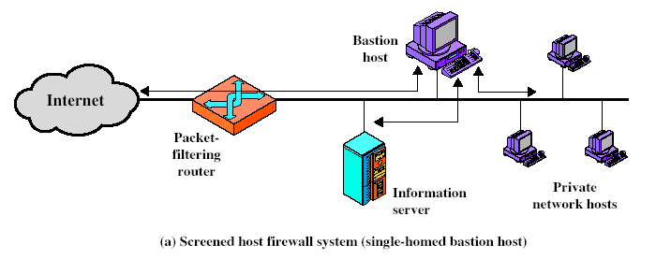
Firewall Configurations
Notes:
Stallings Fig 20-2.

Slide 27
Screened host firewall: single-homed bastion
Consists of a packet filtering router & a bastion host
Router rule:
Inbound: only IP packets destined for bastion host are allowed
Outbound: only IP packets from the bastion host are allowed
Bastion host perform authentication & proxy functions
Better security, because of 2 systems
Router may allow direct traffic between a web server & the internet

Slide 28
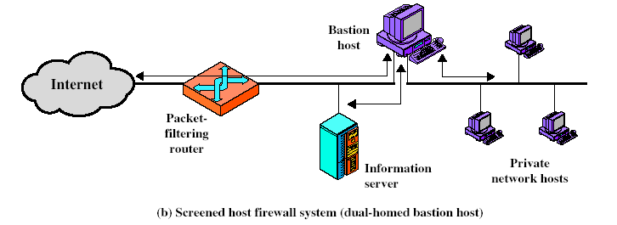
Firewall Configurations
Notes:
Stallings Fig 20-2.

Slide 29
Screened host firewall: dual-homed bastion
Physically prevents security breach found in single-homed bastion
All the previous advantages are present in this configuration as well

Slide 30
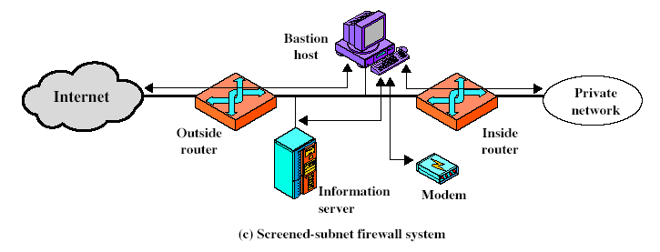
Firewall Configurations
Notes:
Stallings Fig 20-2.

Slide 31
Screened – subnet firewall system
The most secure
3 levels of defense
2 Packet filtering routers & a bastion host are used
Creates an isolation subnetwork
The outside router advertises only the existence of the screened subnet
The internal network is not visible

Slide 32
Summary
have considered:
what a firewall is
types of firewalls
different firewall configurations

Slide 33
Next Lecture
Information Systems Security Management..

Slide 34

Questions?
34

